Slide 1
CHILDREN
Fun time in Islam

Slide 12
Prepare your child for Path, not the path for your child.
Be sure to give your children plenty of praise when they hoe to do their chores…

Slide 14
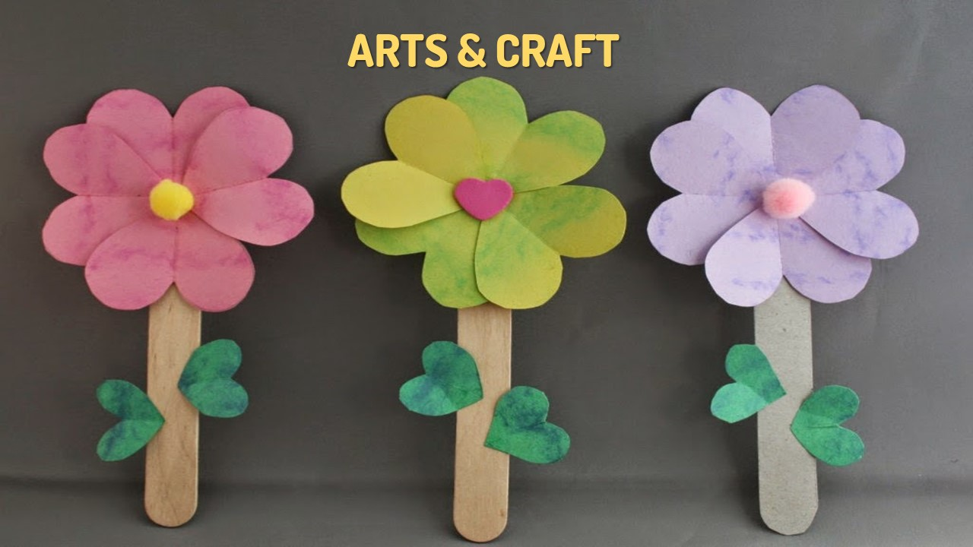

Slide 16
So…

